Slide 1
May the Google be with you:
using the force of Google
to get local clients

Slide 2

Harry Pierce CPHT
Harry’s Journey
Entertaining friends and family with hypnosis
Evolution into a lifelong mission to empower others
Harry’s Credentials
Trained at Midwest Hypnosis School
Certified Hypnotist by the National Guild of Hypnotists
NLP Basic Practitioner of the NFNLP
Certified Professional Hypnosis Trainer for the ICBCH
Website design and Seo since 2006
International Presenter and Successful Practice Owner
Running a prosperous hypnosis practice in Indianapolis
Presented on hypnosis internationally
Author of "The Hero's Journey to a Profitable Hypnosis Practice"

Slide 3
contentS
01
Understanding Local SEO
02
Strong Online Presence
Learn about Local SEO ranking factors And Google’s business philosophy
Verify and Optimize Google My Business Profile Listing
03
Capturing Local Clients
04
Become more Prominent
Optimize the business website for local
SEO and conversion
Build Citations and Local Backlinks and get more customer reviews
05
Get Social
06
Advanced tips & Tricks
Utilize Google Posts and Social Media
Using Analytics, Paid Ads, Tools, etc

Slide 4

What Does Google Want?
Google’s customers are it’s users not the businesses or websites it lists.
It only cares about user experience!
Google tries to connect its users with the best local services they're searching for, just as you aim to provide solutions for your clients' unique needs.
By maintaining a correct and informative online presence, you can enhance your visibility when potential clients search for hypnotherapy services on Google.

Slide 5



01
Local Seo Ranking Factors
Relevance
Distance
Prominence
how much your business matches the user’s query
how close you are to the search user or Search location term
how well-known and well-liked the business is

Slide 6
01
Local Seo Ranking Factors
Relevance:
refers to how well a local Business Profile matches what someone is searching for.
Select the correct primary category
This category should be in your business name and domain too.
Select additional categories
Be as specific as possible and only use categories that relate to your business & services you provide or want to rank for.
Have relevant information on your website and in your business profile
Add complete and detailed business information to help Google better understand your business and match your profile to relevant searches
Relevance
how much your business matches the user’s query

Slide 7
01
Local Seo Ranking Factors
Distance :
considers how far each potential search result is from the location term used in a search.
Verify your business locations
verified Locations Are more likely to show in local search results across Google products, like Maps and Search.
Correctly Claim Your GMB Service Area Business Listing
Google does not allow SAB businesses to display their home address or a non-storefront business address on GMB listings.
If you aren’t using an actual office You can select up to 20 service areas.
Note:
If a user doesn't specify a location in their search, Google will calculate distance based on what they do know about their location.
GBP Hybrid Business
A Hybrid Business is a company that has an office with a physical location that customers come to and These businesses also go out to their customers to service them at their location. (or virtual)
Displays an address and has a service area
user search for “keyword” + City
Uses the city center for user location
Use coworking spaces or virtual office to “pin” a new location
Distance
how close you are to the search user or Search location term

Slide 8
01
Local Seo Ranking Factors
Prominence:
Prominence refers to how well known a business is. Some places are more prominent in the offline world, and search results try to reflect this in local ranking.
Prominence is also based on information that Google has about a business, from across the web
links
Articles
Google review count and review score factor into local search ranking
and directories.
Your position in web results is also a factor
Prominence
how well-known and well-liked the business is

Slide 9

02
verify and optimize GBP
Verify Google Buisness Profile
Go to google.com/business
Create or sign in to your Google Account.
Enter your business name and select next.
Be sure to include category in your name!
Add a business category using the search field.
Enter the street address of your business and hit next.
If you have a service-based business check the box for I deliver goods and services to my customers (it's not a store) only show region.
Select a delivery area option and hit next.
Enter a phone number/website for your business.
Click Continue
Follow the steps to verify your business

Slide 10
02
Add Details To Your Listing
Add Your Website
Select Info from the menu.
Click URLs
Add in your URL.
If you have a Local Page use that URL.
Select Secondary Categories
Businesses can add up to 9 additional categories
Select the pencil icon next to your primary category.
Click Add Another Category and select the categories you would like to add.
Be as specific as possible and only use categories that relate to your business.

Slide 11
02
Add Details To Your Listing
Define Business Hours
Select Info from the menu.
Click the hours section.
Choose a day of the week then use the
toggle to indicate your business is open.
Click the arrow and select Opens at then set a time. Do the same for closing by selecting Closes at.
5. Finish setting your weekly hours then hit apply.
Add a Business Description
Select Info from the menu.
Click Add Business Description.
Write your business descriptions and select apply.

Slide 12
02
optimize Your Listing
Add Photos
Businesses listings with photos receive 42% more driving directions.
From the menu click Photos.
Chose the type of photo or video you would like to add.
Upload the photo or video.
Set Attributes
Click Info
Click the pencil next to the Attributes section.
You can search or scroll to find the attributes you want to add.
When finished click Apply.

Slide 13
02
optimize Your Listing
Add a Menu or Services
Click Info
Select Menu or Services.
Name the menu section.
Add a title, description, and price for each item.
There is also an option to use a third-party source to display your menu or services
Set Up Booking
In the bookings section select Choose A Booking Provider.
Sign up with the provider of your choice.
Within one week your booking account will be linked to your listing

Slide 14
02
optimize Your Listing
Google Posts
One of the best ways to optimize your Google
Listing is by adding Google Posts.
Go to your Google My Business Dashboard.
Select the location you would like to manage.
Click Create Post.
Select the post type.
Add your photo or video, text, offer, and button.
Click Preview to see the post before you publish.
Hit Publish in the top right corner of the preview page if you are happy with your post.
Answer Questions From The Community
Your GMB account will notify you of new questions.
Next to the question click Answer.
To edit or delete your answer click the 3 dots and select an option.

Slide 15
02
optimize Your Listing
Manage Your Reviews
One of the best ways to optimize your Google
Listing is by adding Google Posts.
Remind your customers to leave reviews.
You can do this in person or create and share a link asking them to leave a review on your listing.
  Search for your business on your computer.
  Find your business and click Write A Review.
  Copy and paste the URL you see in your address bar.
Remember: Don't gate negative reviews, if you ask people to leave you a Google review, it must be published to your public listing

Slide 16
02
optimize Your Listing
Responding to Reviews
Businesses who respond to reviews not only rank higher but they create more returning and new customers
Click Reviews from the menu.
Click Respond to reply to a customer review.
Write a response and click Submit.
When responding, keep in mind that your responses are public for everyone to read.

Slide 17
02
How to respond to bad reviews
Respond in a timely manner. Customers will appreciate a prompt response.
Stay professional and courteous. Never lash out and avoid taking the review personally.
Understand your customer’s experience with your business before responding. If someone mentions a problem with a service, investigate to see what may have gone wrong.
Be honest about mistakes made and steps you’ve taken (or will take) to remedy the situation.
Apologize when appropriate but don’t take responsibility for things that weren’t your fault.
Show compassion and empathy for the customer.
Show that you’re authentic and genuine. Sign off with your name or initials to show you’re taking the matter seriously and that a real person is listening

Slide 18


Website Landing Pages
Hero Section
Should tell visitors: What you do, Why it matters, And what they need to do to get it!
Headline emphasizes result or transformation
H1 should have primarily category name and location
Example: “Stop smoking in Denver today”
Sub-headline
Clearly explains what you provide to get that result
H2 again primarily category & location
Example "The most trusted hypnosis in Denver“
Call to Action
Clear next step to get started
Results
List 3 results your clients will get working with you
Hero Image
Happy client – show the result
Hero image location-category.jpg
Alt text also has location and primary category

Slide 19
Website Landing Pages
Problem/soultion Section
Should tell visitors: you understand their problem!
Talk about the main pain point
Example: you know you should quit smoking, but it’s hard to stop without help
Agitate with examples
Tell a client story about the struggles they had
Really focus on the discomfort
Introduce your solution
Continue the story with the solution
Emphasize how it was easier, faster or more certain
With your solution
Image or video testimonial
Let your client success do the talking for you
Include location and category information where appropriate
Take advantage of file names, and alt text here too

Slide 20
Website Landing Pages
Benefits Section
Should tell visitors: why what you do is different!
List the benefits of working with you
why hypnosis does this better
Why hypnosis does this faster
Why is hypnosis more likely to succeed
Example: Hypnosis helps you quit smoking faster
Explain the feature that makes it possible
What about hypnosis makes that benefit possible
Testimonial Section
text or video testimonial
Let your client success do the talking for you
Include the city and state with the client name
Include ones that overcome objections, or highlight benefits
Include location and category information where appropriate
Take advantage of file names, and alt text here too

Slide 21


Become more Prominent
Build Citations and L ocal Backlinks
Your website and business should be everywhere!
Claim and optimize your business listing on directories
Yelp, Bing Places, facebook, BBB, etc.
Make sure that your listings are complete and accurate (and match your GBP exactly!)
Create a business prole on local listings sites
Yellow Pages, Citysearch, and Angie's List
Make sure they match your GBP
Get listed in local and industry-specific directories
Online hypnosis and hypnotist directories
Local Chamber of commerce
association directories, and trade organization directories that are relevant to your business
Seek out local media coverage
Newspapers, Radio, and Television stations have websites too

Slide 22


Get Social
Create high-quality content
Make content that is relevant to your local audience
Share this content on your website, social media channels, other platforms to attract new links
Create a business prole on local listings sites
Yellow Pages, Citysearch, and Angie's List
Make sure they match your GBP
Network with other local businesses & look for opportunities to collaborate
such as guest blogging or podcasts
Get a guest spot on Industry specific blogs or podcasts
link exchanges
Use social media to promote your business
Share your content
post updates about your business
respond to customer reviews

Slide 23

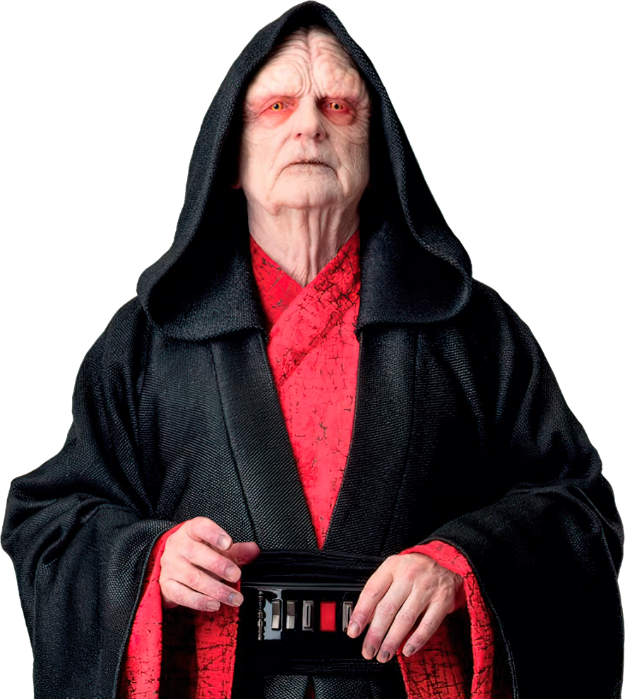
Advanced Tricks
Host events or sponsor local events
Many local event websites list sponsors and partners
Great way to get new clients
Also get media coverage
support charities or organizations you believe in
submit your business to local data aggregators
Local data aggregators collect and distribute business information to a wide range of directories
and search engines.
increase your visibility in local search results
And generate citations.
Create a Wikipedia page for your business
widely-used and respected source of information
can help to generate backlinks and citations from other websites.

Slide 24
Advanced Tricks
Analyze your competition
Use a backlink analysis tool
Tools such as Ahrefs, SEMrush, and Majestic
enter a competitor's website and view a list of the backlinks pointing to their website
Use Google search console
use the "Links" report to see which sites are linking to competitors
Gives a list of the websites and pages that are linking to your competition
Check link-building strategies
Look at other hypnotist’s websites and see what kind of strategies they use
Do they have a resource page?
do they guest post on other websites?
do they participate in online communities or forums?

Slide 25
Advanced Tricks
Analyze your competition
Use a backlink analysis tool
Tools such as Ahrefs, SEMrush, and Majestic
enter a competitor's website and view a list of the backlinks pointing to their website
Use Google search console
use the "Links" report to see which sites are linking to competitors
Gives a list of the websites and pages that are linking to your competition
Check link-building strategies
Look at other hypnotist’s websites and see what kind of strategies they use
Do they have a resource page?
do they guest post on other websites?
do they participate in online communities or forums?

Slide 26

Final Advice
Be consistent with your business information across all platforms you must.
use local keywords in your website's content, meta tags, and alt tags, but use them in a natural and relevant way you should.
Respond to reviews, both positive and negative, in a timely and professional manner. Remember to not give in to hate for it is the way to the dark side.
Use the power of storytelling in your Google Posts. make them more engaging it will, and will increase the chances of them being shared.

Slide 27
THANKS

Slide 28
resources
https://herosjourneyhypnosis.com/mihc23/
https://libertybusinesshub.com/
Where to contact me
https://hoosierhypnosis.com/
317-699-1066
hoosierhypnosis@gmail.com

